Slide 1

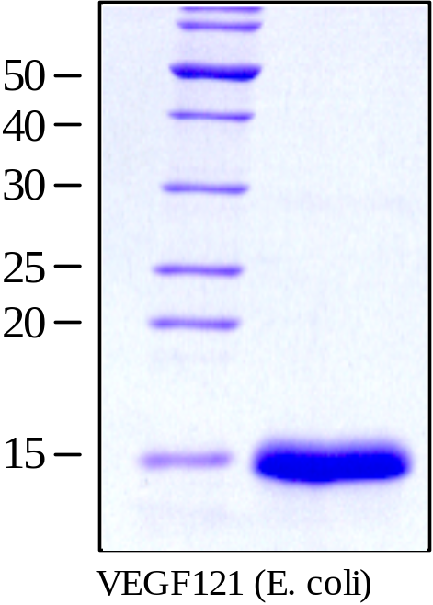
ReliaTech GmbH
Recombinant human VEGF121
(Cat #300-071S / -071 / -072)
Fig. 1: SDS-PAGE analysis of recombinant human VEGF121 produced in E. coli. Sample was loaded in 15% SDS-polyacrylamide gel under reducing conditions and stained with Coomassie blue.
http://www.reliatech.de / orders@reliatech.de

